Slide 1

1. Defining
2. Locating
3. Selecting
4. Organising
5. Presenting
6.
Assessing
Information Skills Process
Notes:
Earthquake explorers before we begin our quest into earthquakes
Let us revisit our Information Search Process

Slide 2
1. Defining
What do I want to find out?

Slide 3
2.
Locating
Where can I find the
information I need?

Slide 4
3.
Selecting
What information
do I really need to use?

Slide 5
4.
Organising
It lives…
It looks like…
How can I use this
information?
It eats…

Slide 6
5. Presenting
MY PROJECT!
How can I present this information?

Slide 7
6.
Assessing
What did I learn from this?

Slide 8
1. Defining
2. Locating
3. Selecting
4. Organising
5. Presenting
6.
Assessing
Information Skills Process
Notes:
Earthquake explorers before we begin our quest into earthquakes
Let us revisit our Information Search Process

Slide 9
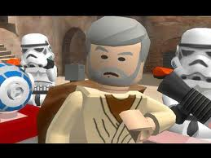
GOOD LUCK ON YOUR
INFORMATION QUEST
http://www.flickr.com/photos/dugspr/5559556019/Retrieved 23/9/2012

